Slide 1
Test Design Techniques
Andrii Artysh
January 2016

Slide 2

Agenda
Equivalence Partitioning
Boundary Value
Test Case
Decision Tables
State Transition

Slide 3
Equivalence Partitioning
Condition : In a system designed to work out the tax to be paid: An employee has $1000 of salary tax free. The next $500 is taxed at 10%. The next $4000 is taxed at 22%. Any further amount is taxed by 40%. Salary cannot be larger than $6000.
Equivalence Partitioning values:
-30.2
50.8 for tax 0%
300.9 for tax 10%
2250.7 for tax 22%
5000.4 for tax 40%
8000.3
Invalid | Tax 0% | Tax 10% | Tax 22% | Tax 40% | Invalid
-0.1 | 0.0 100.0 | 100.1 500.0 | 500.1 4000.0 | 4000.1 6000.0 | 6000.1

Slide 4
Boundary Values
Condition : In a system designed to work out the tax to be paid: An employee has $1000 of salary tax free. The next $500 is taxed at 10%. The next $4000 is taxed at 22%. Any further amount is taxed by 40%. Salary cannot be larger than $6000.
Boundary values:
-0.2 , -0.1
0.0 , 0.1 , 99.9 , 100.0 for tax 0%
100.1 , 100.2 , 499.9 , 500.0 for tax 10%
500.1 , 500.2 , 3999.9 , 4000.0 for tax 22%
4000.1 , 4000.2 , 5999.9 , 6000.0 for tax 40%
6000.1 , 6000.2
Invalid | Tax 0% | Tax 10% | Tax 22% | Tax 40% | Invalid
-0.1 | 0.0 100.0 | 100.1 500.0 | 500.1 4000.0 | 4000.1 6000.0 | 6000.1

Slide 5
Test Case
Test case name
Verify correct calculation employee's tax
Test case objective
Employee paid tax which depend from salary.
Salary can not be larger than 6000$

Slide 6
Decision Tables
Condition : You take a loan in a bank. The bank gives you loan application, where you can enter the amount of the monthly re-payment or the number of years you want to take to pay it back (the term of the loan). You should infill only one of the proposed fields. If you enter both, then you will get an error message.
Choose re-payment by the months
Choose re-payment by the years
User can infill only one of the proposed fields

Slide 7
* Should client received some error message in this situation ?
Decision Tables
Causes (inputs) | R1 | R2 | R3 | R4
Re-payment by months | Y | Y | N | N
Re-payment by years | Y | N | Y | N
Cause (output)
Re-payment |  | ^{Months} | ^{Years}
Error message | v |  |  | v*

Slide 8
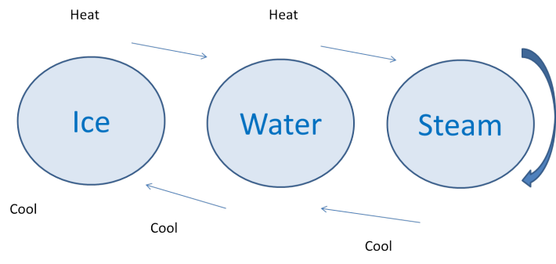
State Transition
Condition : Customer chooses Arabica coffee from coffee machine. He selects specific sort of coffee (in this case Arabica), and enters money. If not enough money is entered, then machine will ask to enter more. If amount of money is ok, then machine will start doing coffee. If Arabica coffee is available, then customer will get coffee and his change in a minute. If there is no selected sort of coffee, then customer will get proper message and his money back.

Slide 9
State Transition Diagram
not
enough
money
for
coffee
Choose
coffee
Enter
money
Select
Arabica
not enough
money for coffee
coffee
is paid
coffee
is paid
Coffee machine
doing coffee
Arabica
coffee is
available
Arabica
coffee is
not
available
Customer received
Coffee and change
Customer received
proper message and
money back

Slide 10
Thank you

